Slide 1
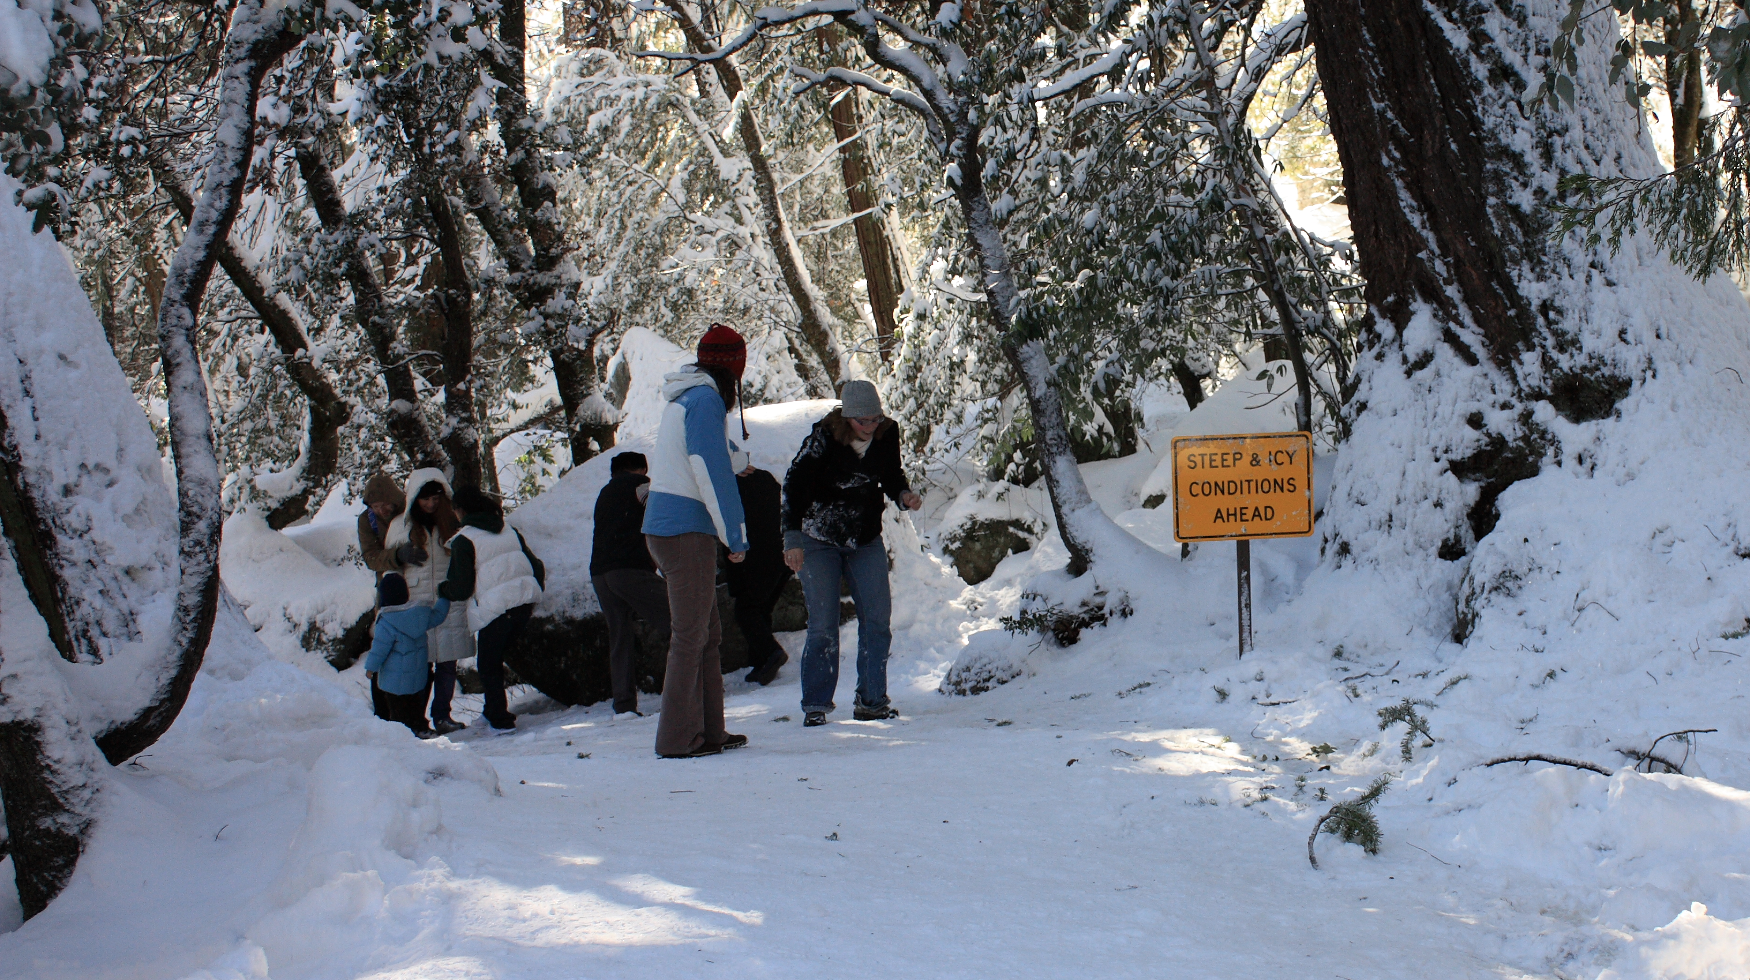
Class 7:
Merkle Trees
Cryptocurrency Café
UVa cs4501 Spring 2015
David Evans

Slide 2
Plan for Today
Blockchain Recap
Exploring the bitcoin core code
Recording Transactions
Merkle Trees

Slide 3
Plan for Next Week
Monday:
Project 2: explanation, help
Q/A: answer questions on anything so far
(post on course site, send by email, ask in class)
Wednesday:
In-class quiz: understanding main concepts so far
Mining

Slide 4
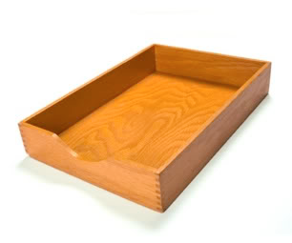
What happened to proof-of-work for sending email?

Slide 5
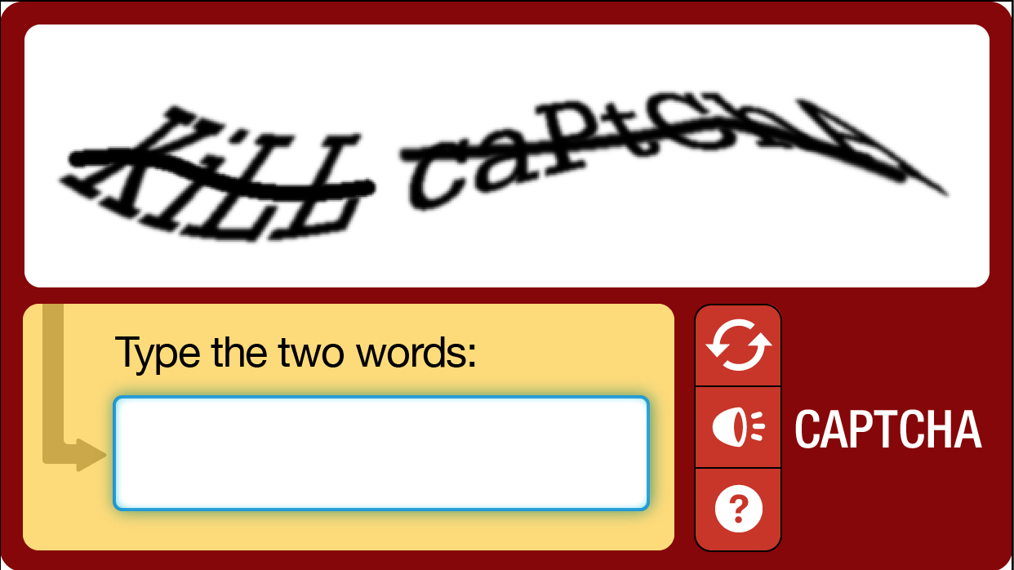
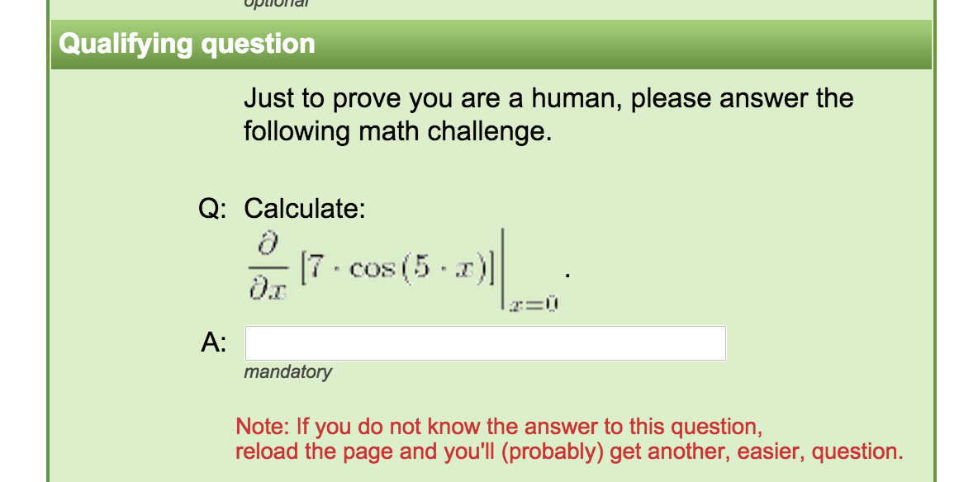
Instead of making computers do inane, repetitive work to prevent mass automation, we make humans do inane, soul-killing work!

Slide 6
Blockchain Recap
B0
H(B0)
Nonce
H(B1)
Nonce
H(B2)
Nonce
Transactions
Transactions
Transactions
Find a nonce x such that:
SHA-256(SHA-256(r + x)) < T/d
r = header + transactions (including mining fee)
header includes H(previous block)

Slide 7
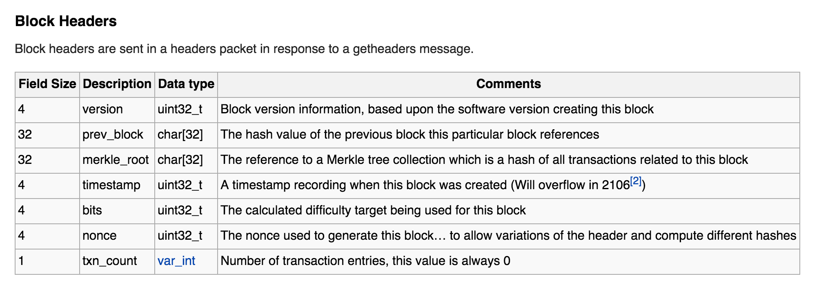
Actual Bitcoin Block
https://en.bitcoin.it/wiki/Protocol_documentation#Block_Headers

Slide 8
Let’s Look at Some Blocks…
http://blockexplorer.com/b/341537
http://blockexplorer.com/b/0

Slide 9
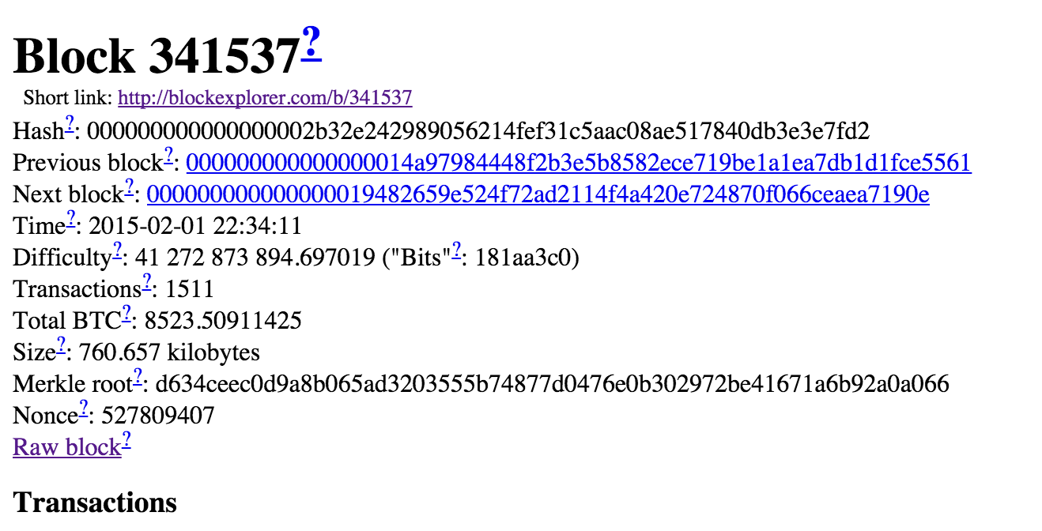

Slide 10
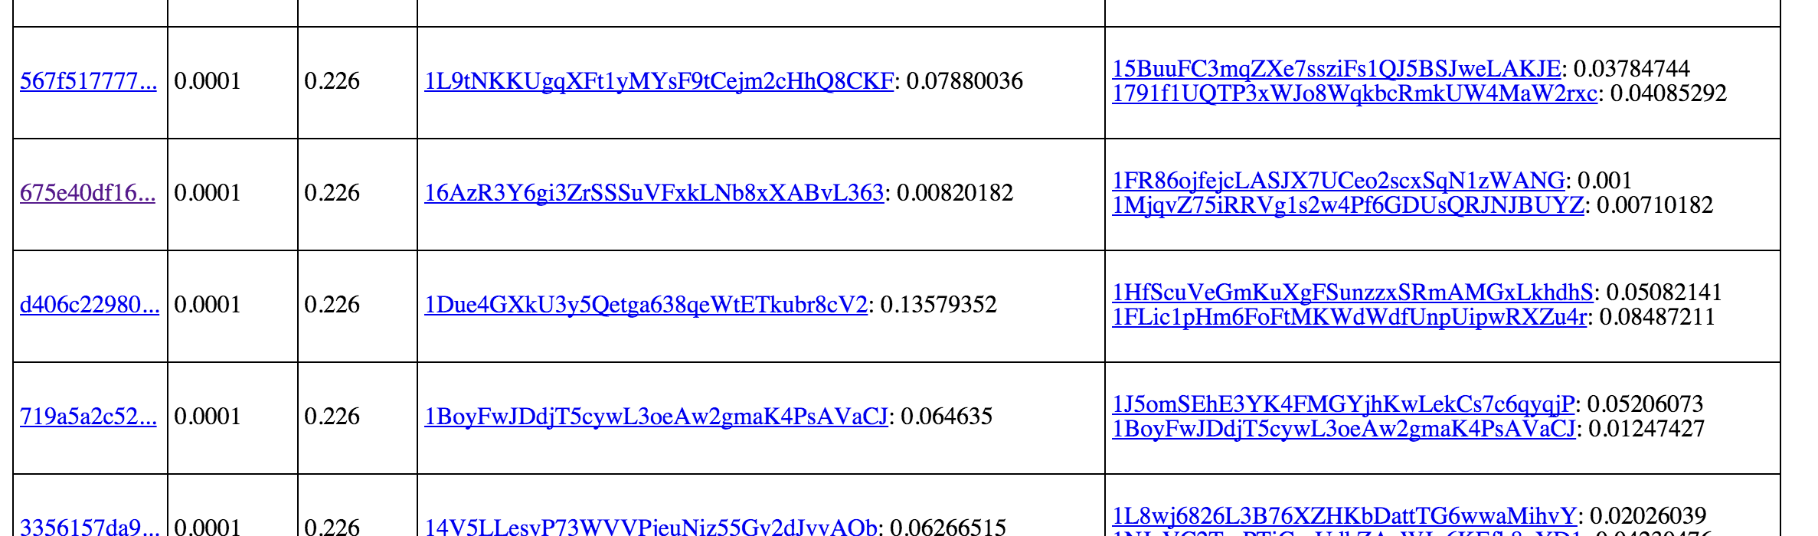

Slide 11
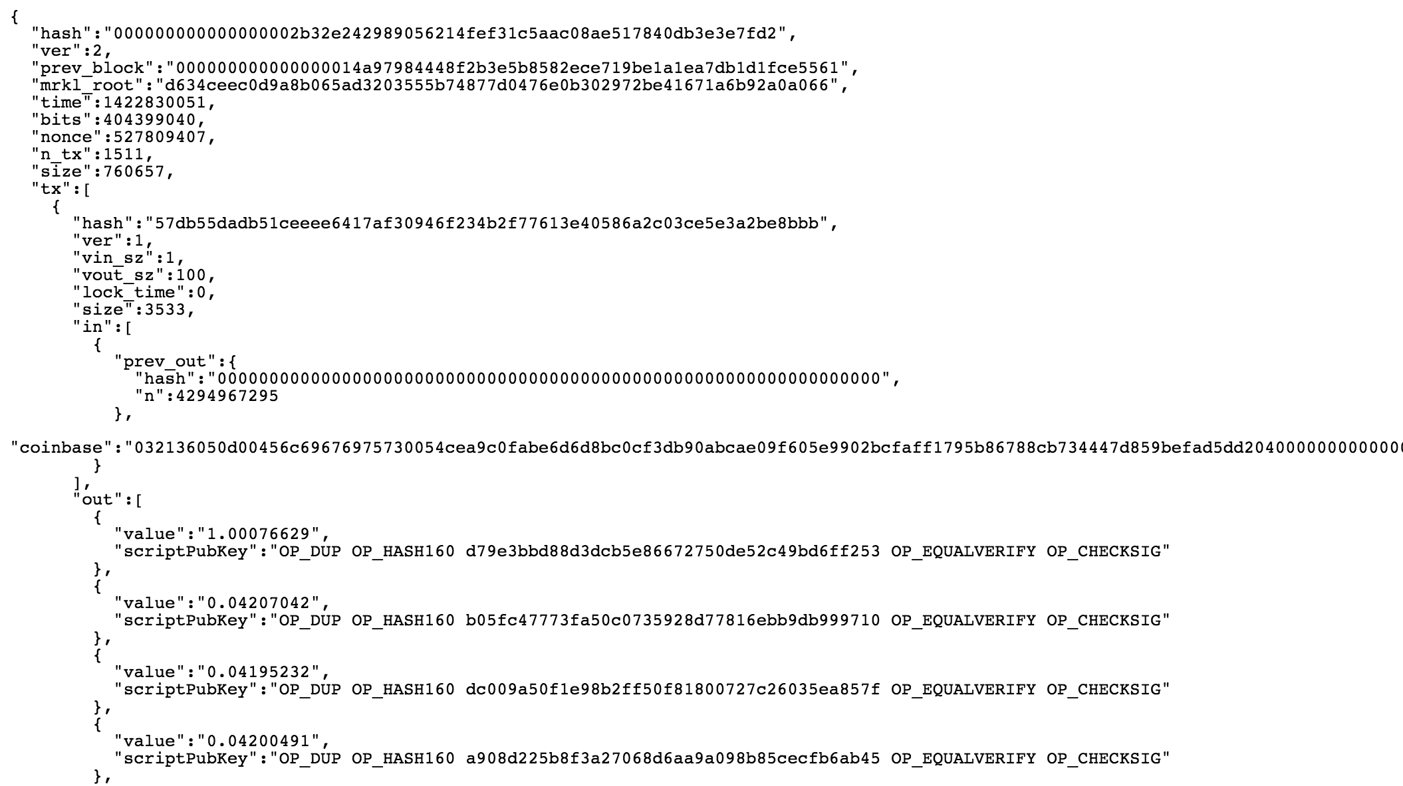

Slide 12
Let’s Look at Some Code…
https://github.com/bitcoin/bitcoin/blob/master/src/primitives/block.h
https://github.com/bitcoin/bitcoin/blob/master/src/miner.cpp

Slide 13
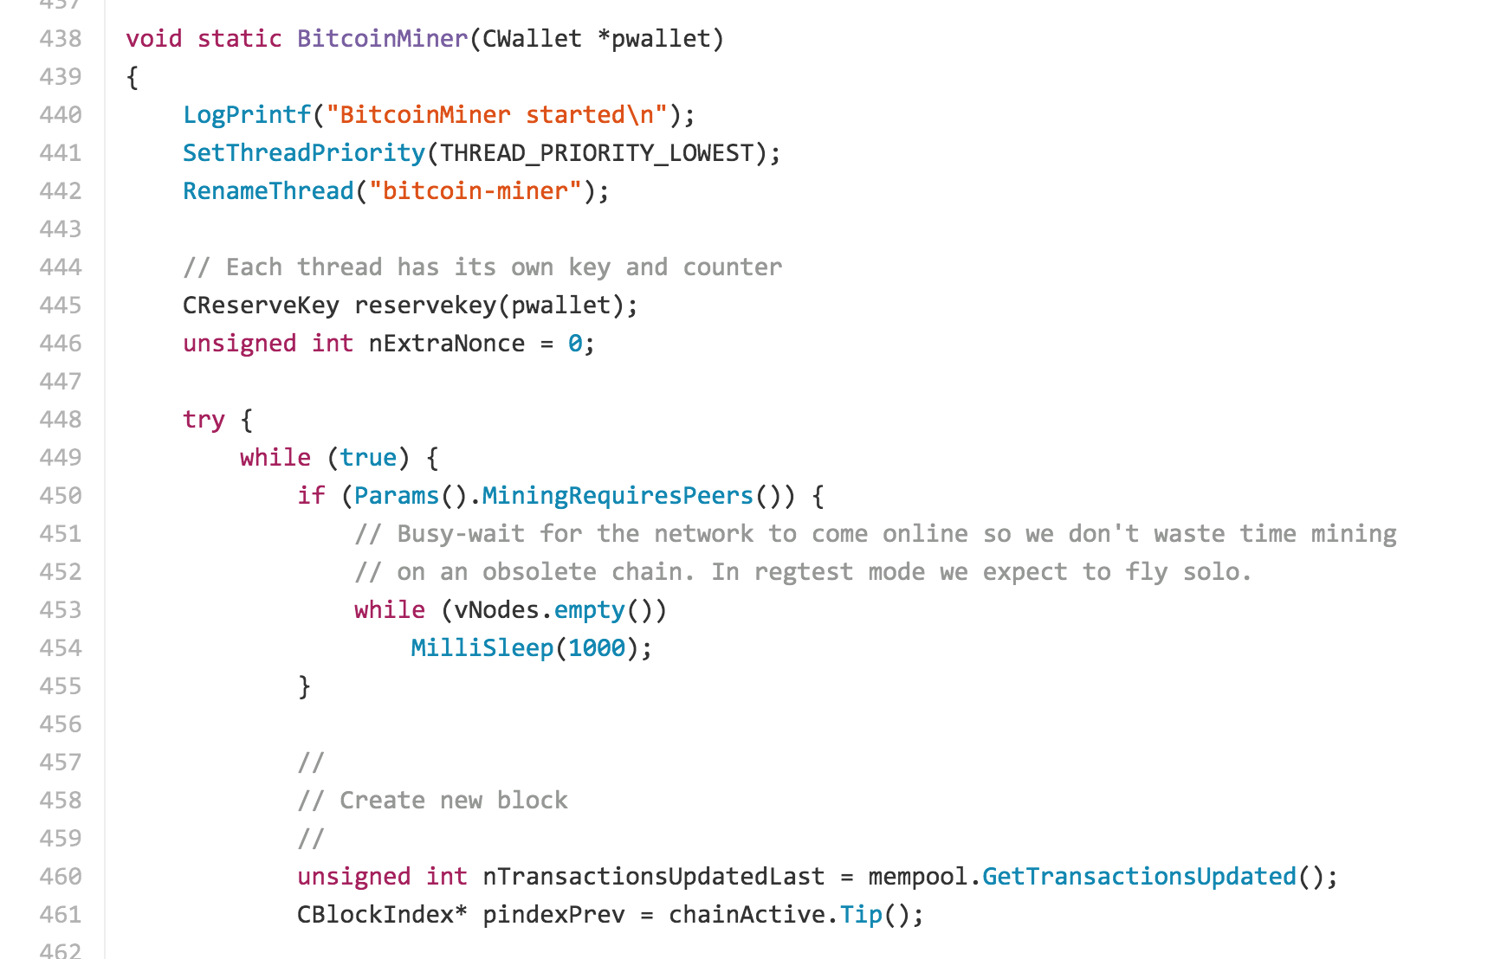
from bitcoin core:
bitcoin/miner.cpp
https://github.com/bitcoin/bitcoin/blob/40e96a30160ddc2cb39bc9b86ec103ac892e09ab/src/miner.cpp#L486

Slide 14
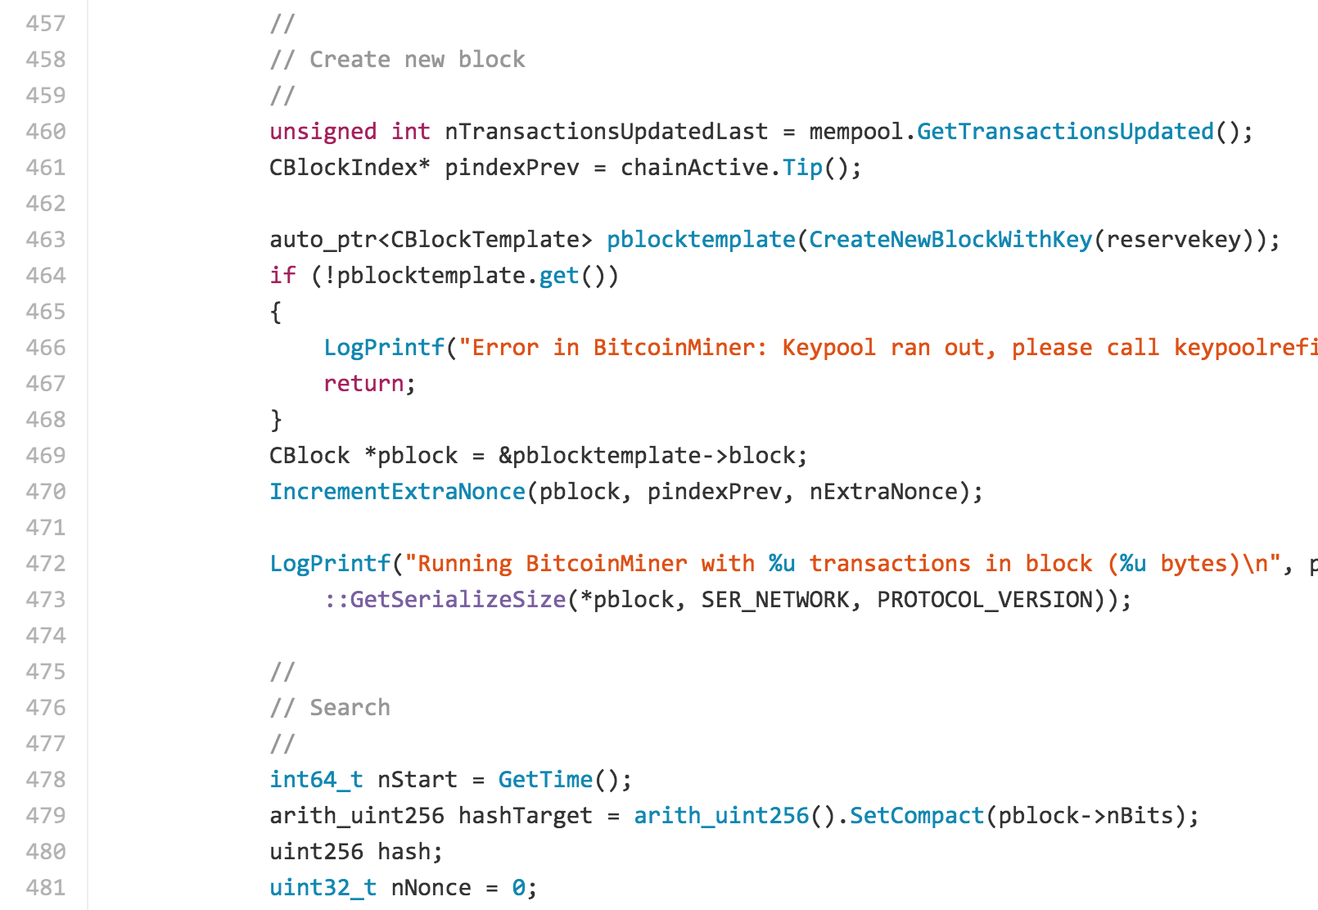
from bitcoin core:
bitcoin/miner.cpp

Slide 15
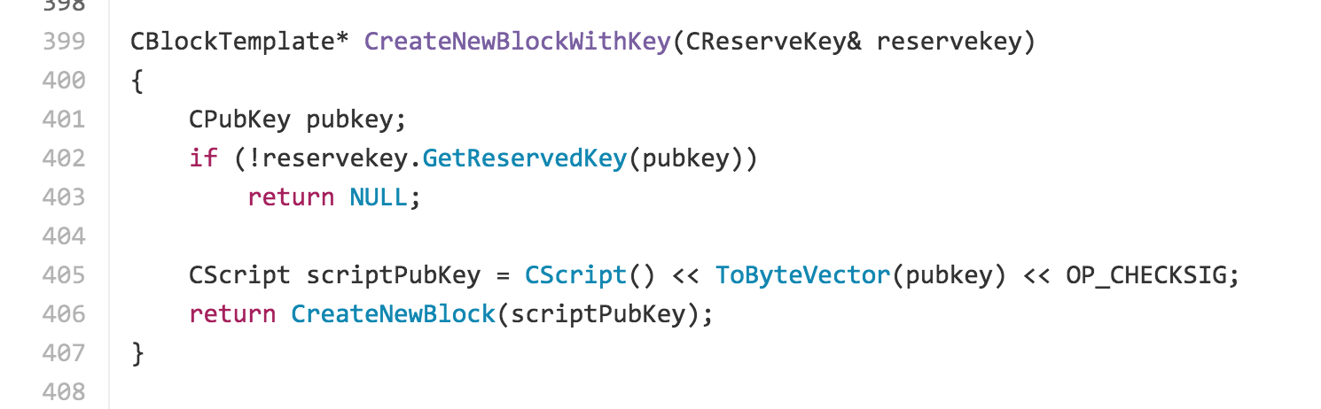
from bitcoin core:
bitcoin/miner.cpp
CreateNewBlock

Slide 16
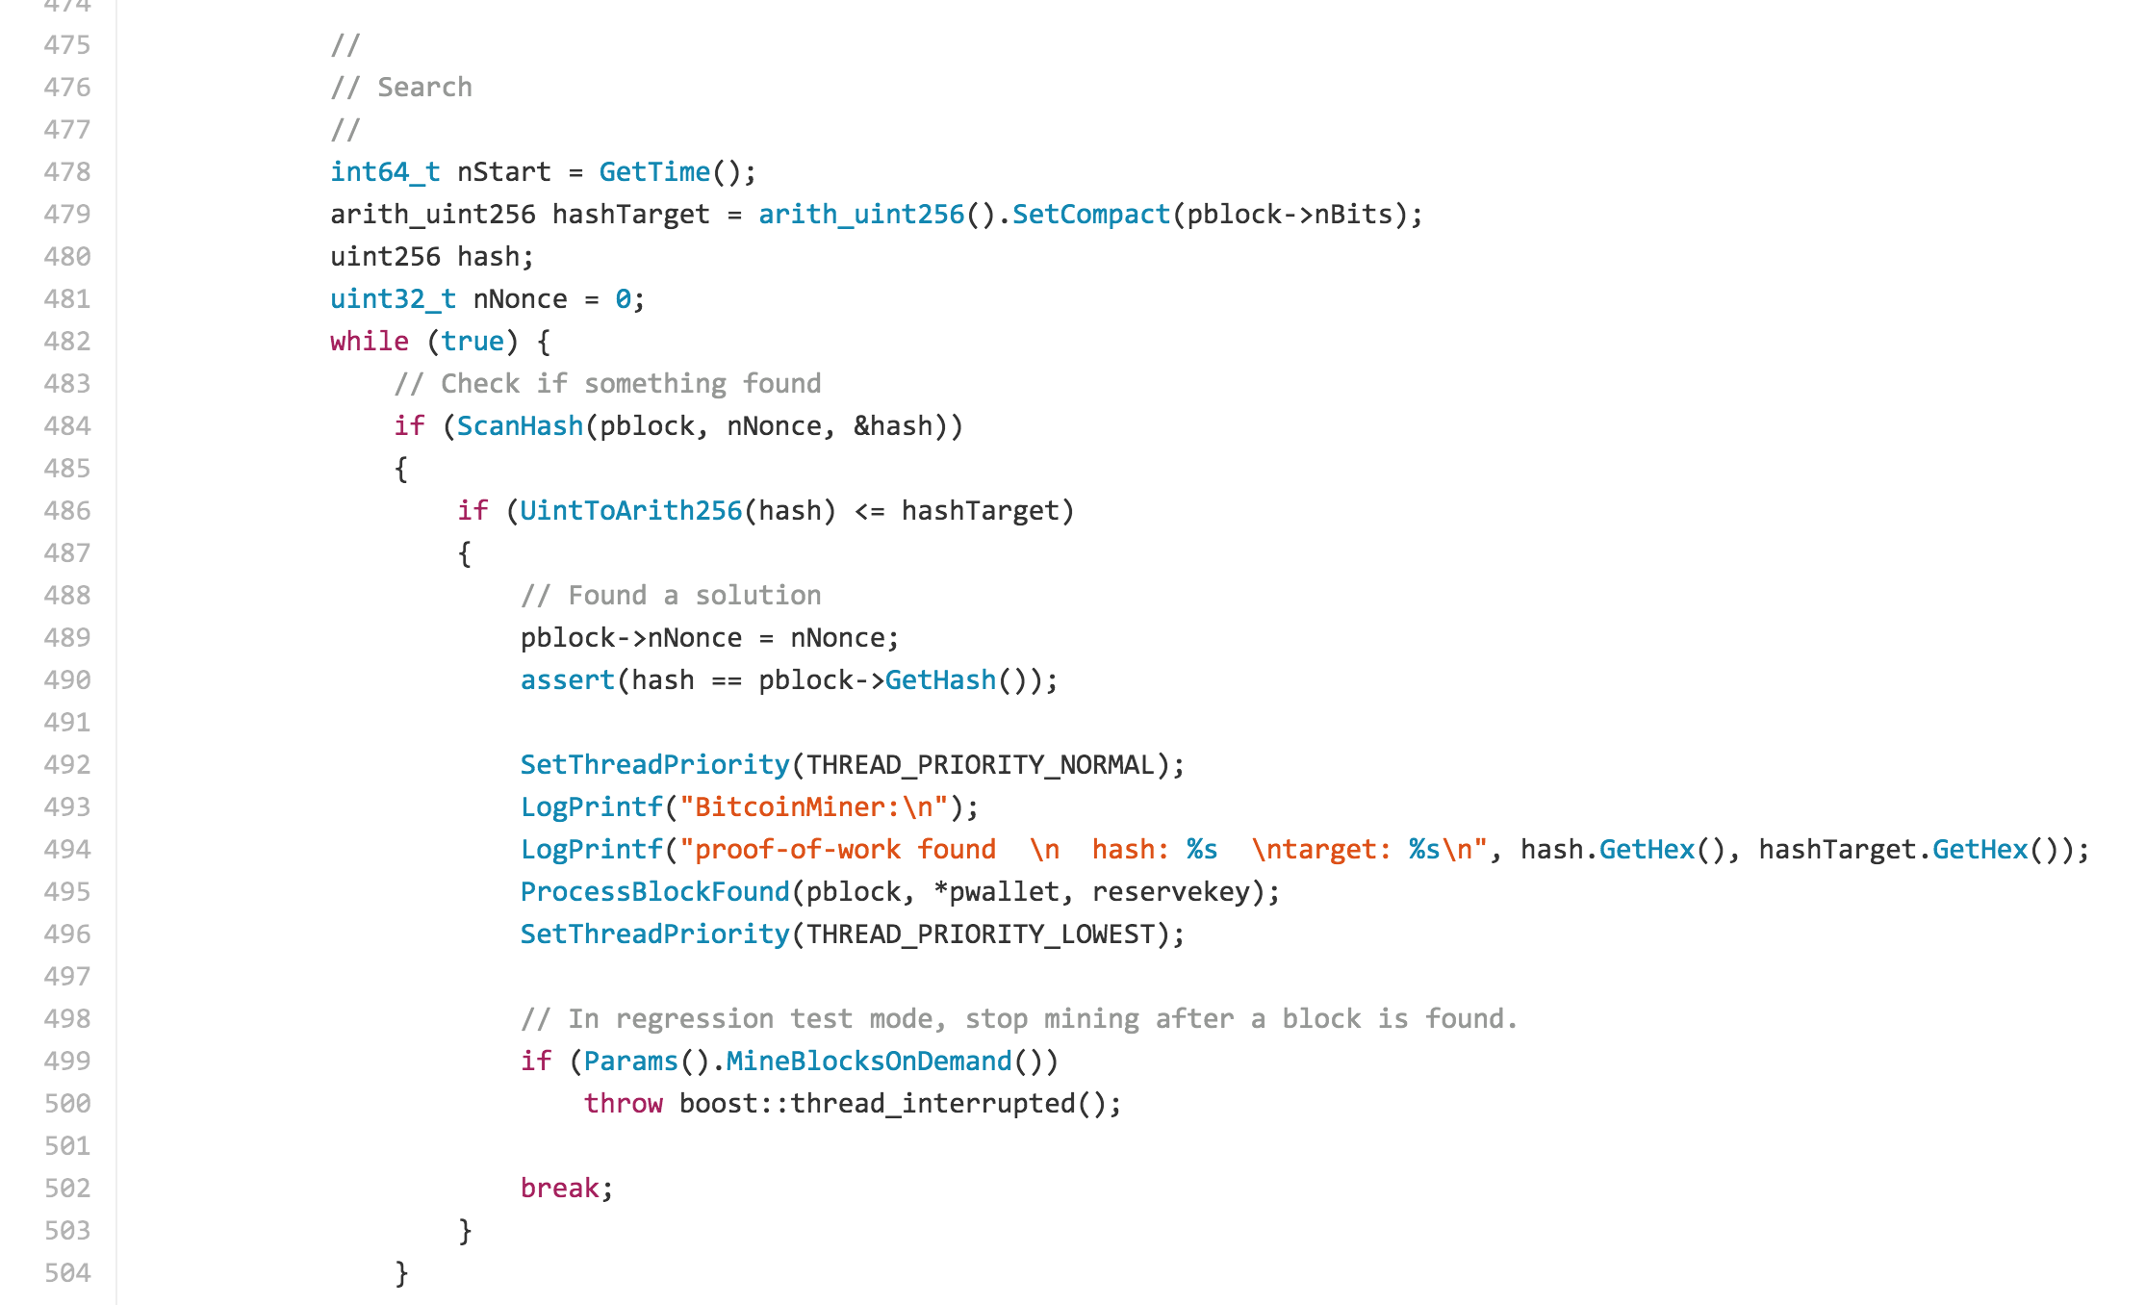

Slide 17
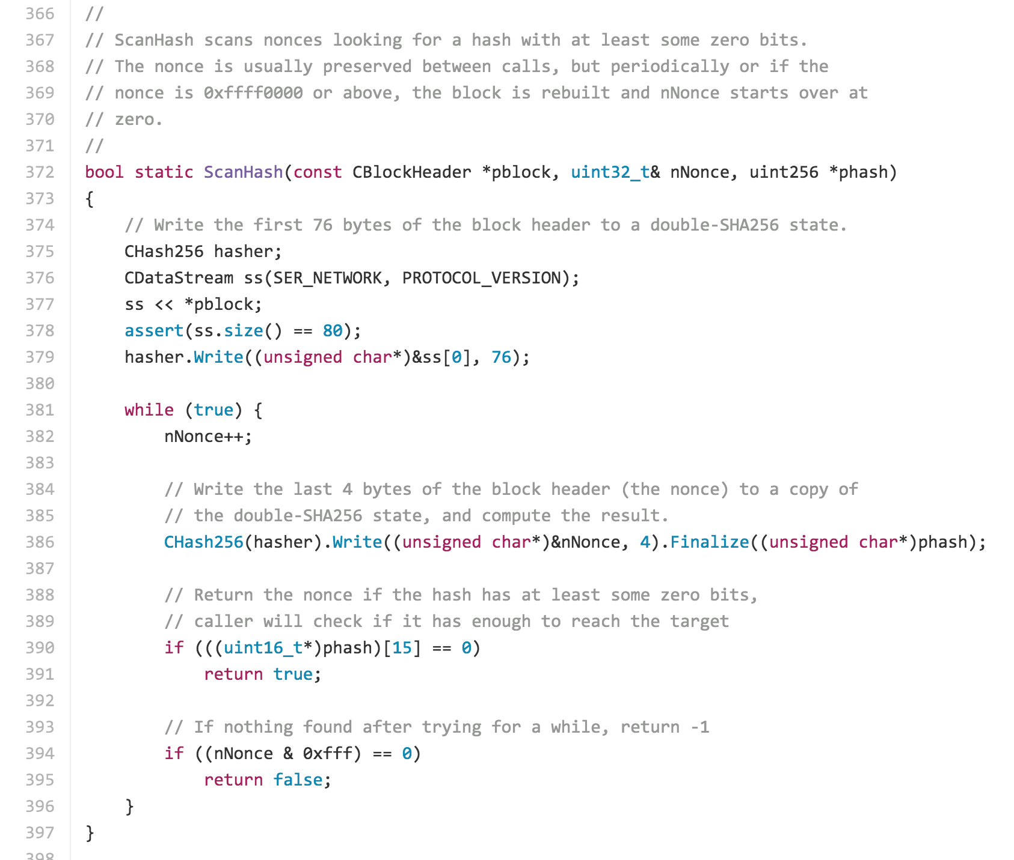

Slide 19
Recording Transactions
Mining next block:
Find a nonce x such that:
SHA-256(SHA-256(r + x)) < T/d
H(B2)
Nonce
Transactions
r depends on the actual transactions…which keep happening!

Slide 20
Bad Idea #1?
transactions = H(tx₀ || tx₁ || tx₂ || … || tx_{n})

Slide 21
Bad Idea #2?
transactions = H(tx₀) || H(tx₁) || H(tx₂) || … || H(tx_{n})

Slide 22
Slightly Better Idea
transactions = H(tx_{n} || H(tx_{n-1} || H(tx_{n-2} || … || H(tx₁))))))

Slide 23
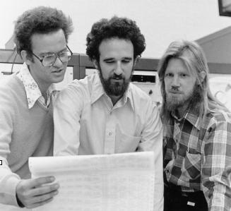
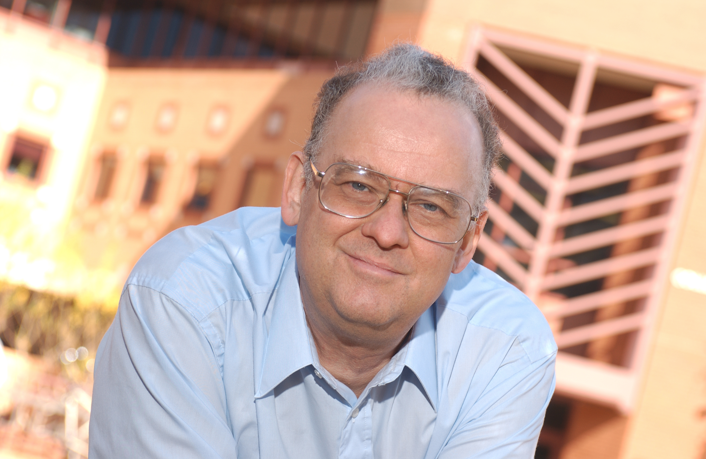
Merkle Trees
Ralph Merkle with
Martin Hellman, Whitfield Diffie (1977)
Diffie-Hellman(-Merkle) Key Exchange (1976)

Slide 24
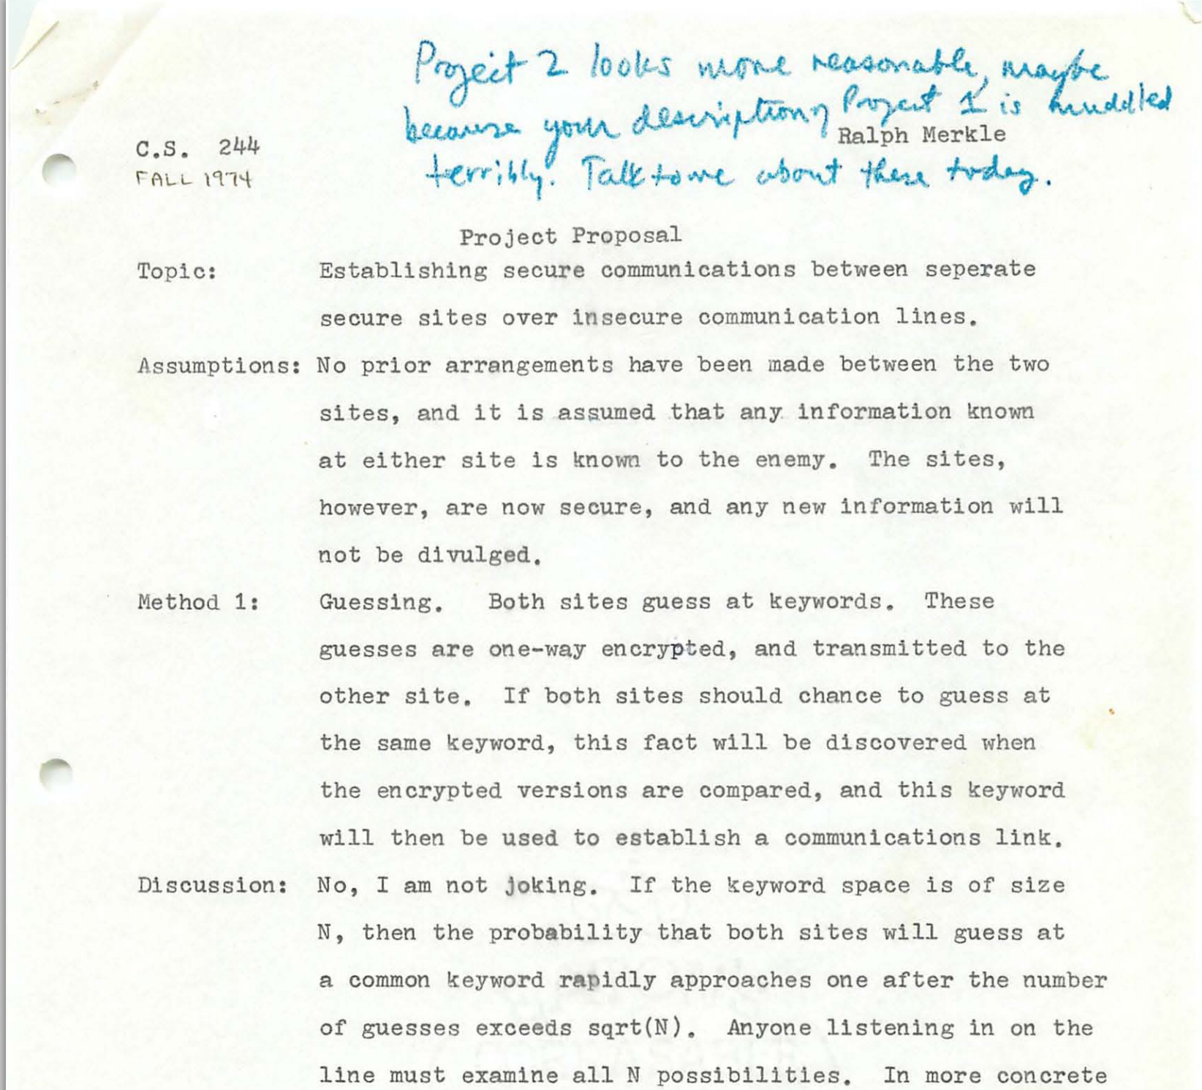
Merkle’s Puzzles

Slide 27
Merkle Trees

Slide 28
Hashing the Hashes
Hash(T1)
Hash(T2)
Hash(T3)
Hash(T4)
Transaction 1
Transaction 2
Transaction 3
Transaction 4

Slide 29
H_{root}= h(H₁₂ + H₃₄)
H₁₂= h(H₁ + H₂)
H₃₄= h(H₃ + H₄)
H₁ = h(T₁)
H₂= h(T₂)
H₃=h(T₃)
H₄=h(T₄)
T₁
T₂
T₃
T₄

Slide 30
Charge
Project 2 will be posted by tomorrow, and you should get started before Monday’s class.
If you did not receive a grade for Project 1 yet, you have until tomorrow to contribute a worthwhile comment to justify full credit for Project 1.
Next Wednesday: quiz on what we’ve done through today
(including readings book through Ch 7 and Satoshi’s paper)
Goals: (1) encourage everyone to review and make sure you understand key ideas; (2) give me a good sense of what people understand

